Slide 1
SEO Audit Project
Name:megha rawat

Slide 2
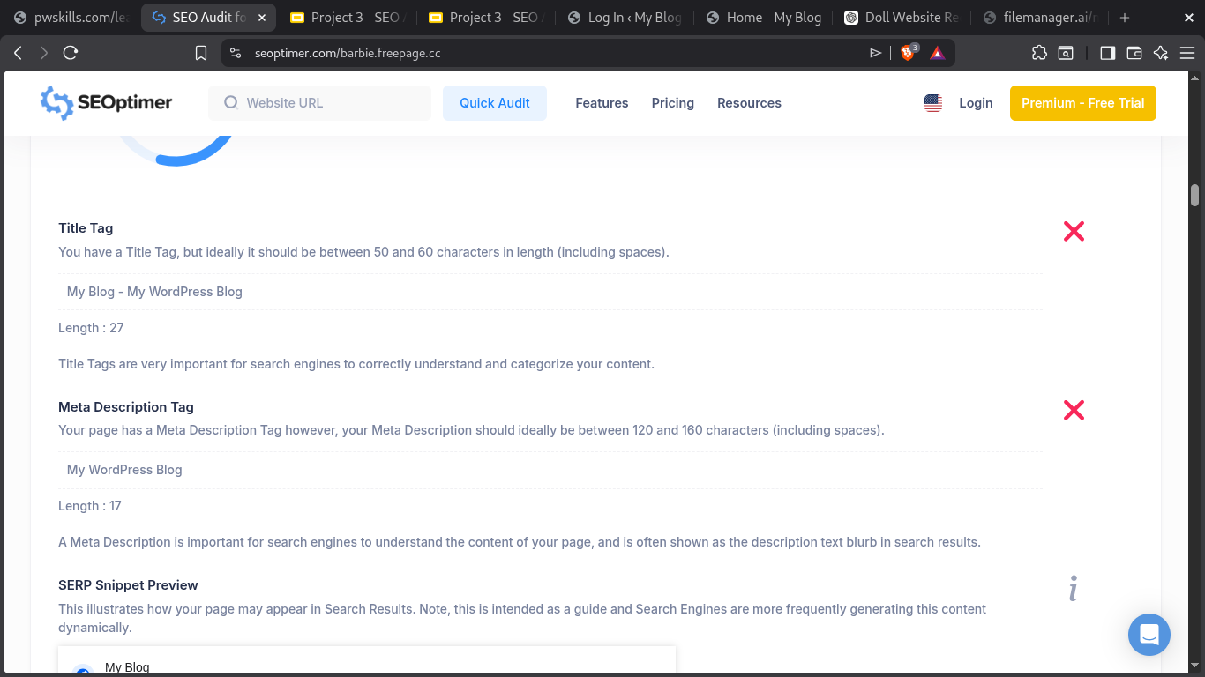
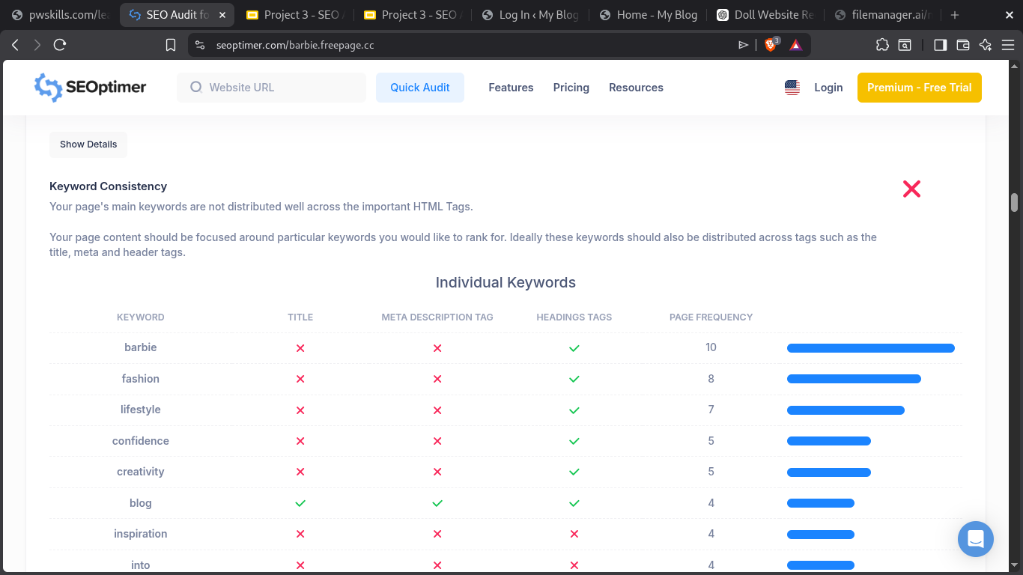
Q.1. Identify at least 5 potential issues related to Content from the SEO Audit for your website & suggest the optimization ways.
Issues
Optimization Ways
1 Missing Meta Description
2 Title Tag Too Long/Short
3 Missing Image Alt Text
4 Low Keyword Optimization
5 Thin Content
1Add a unique meta description
2 Keep the title between 50–60 characters.
3 Add descriptive alt text to every image.
4 Use keywords like Barbie dresses, Barbie clothes, Barbie fashion naturally in headings and content.
5 Increase product descriptions to 200–300 words with useful information.

Slide 3
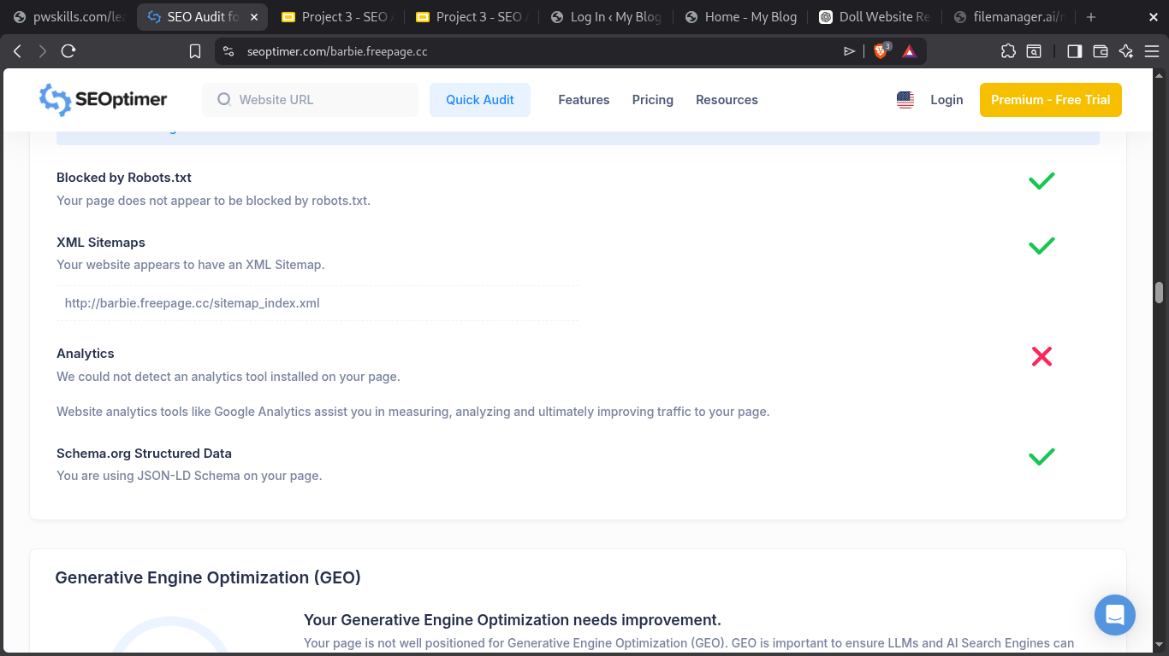
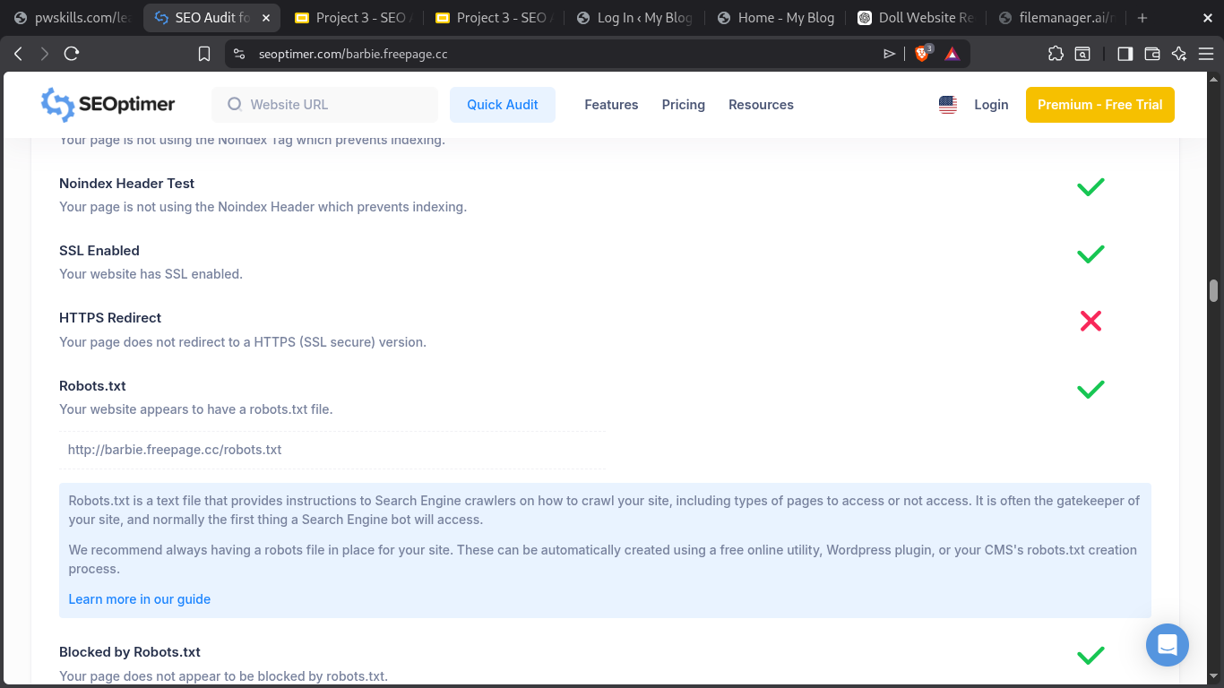
Q.2. Identify at least 5 potential issues related to Technical from the SEO Audit for your website & suggest the optimization ways.
Issues
Optimization Ways
1 Missing XML Sitemap
2 Missing robots.txt
3 Broken Links
4 Slow Page Load
5 Mobile Optimization
Create and submit an XML sitemap to Google Search Console.
2.Add a robots.txt file to guide search engine crawlers.
3.Fix or remove broken internal and external links.
4.Compress images, enable browser caching, and minify CSS/JS.
5.Ensure the website is responsive on all devices.

Slide 4
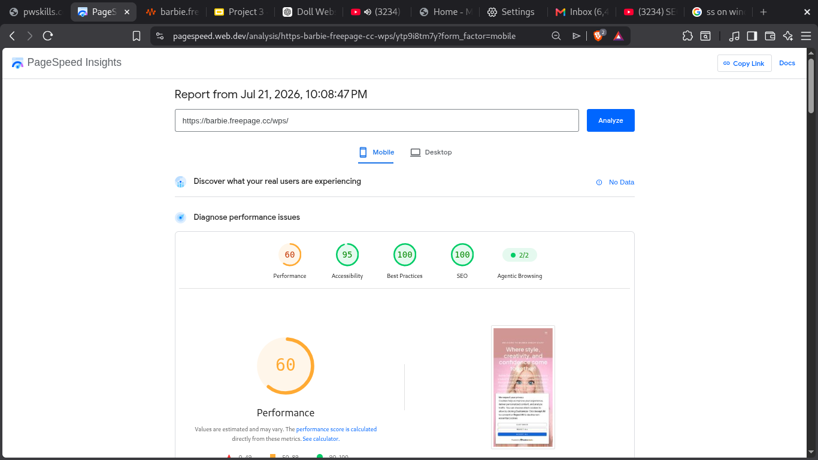
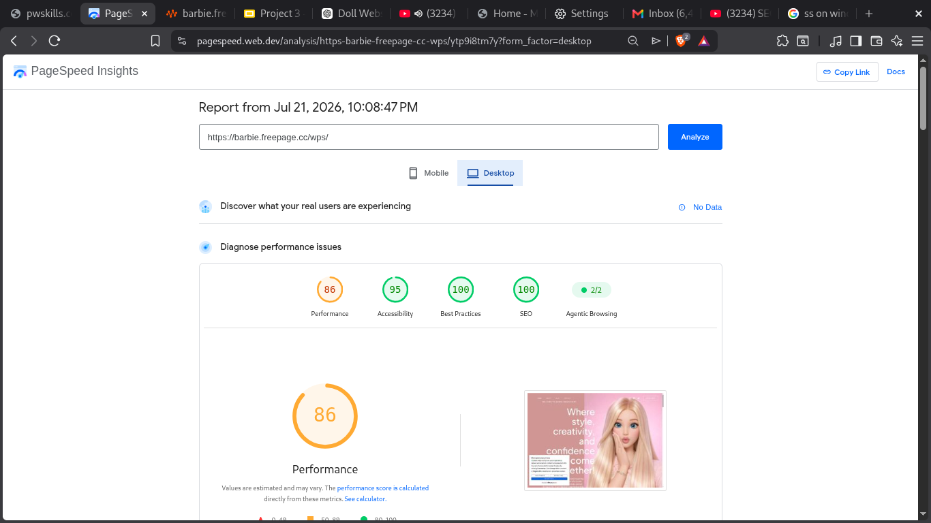
Q.3. Perform the Speed test for your website and provide the screenshot – for Mobile and Desktop

Slide 5
Q.4. Suggest the optimization ways which you are going to follow to improve the website’s speed (At least 3).
Optimize Images
Compress images and convert them to WebP format to reduce file size and improve loading speed.
Reduce Render-Blocking Resources
Minify CSS and JavaScript files, defer non-essential scripts, and load CSS efficiently so the page renders faster.
Remove Unused CSS and JavaScript
Eliminate unnecessary CSS and JavaScript code to reduce page size and improve performance.

Slide 6
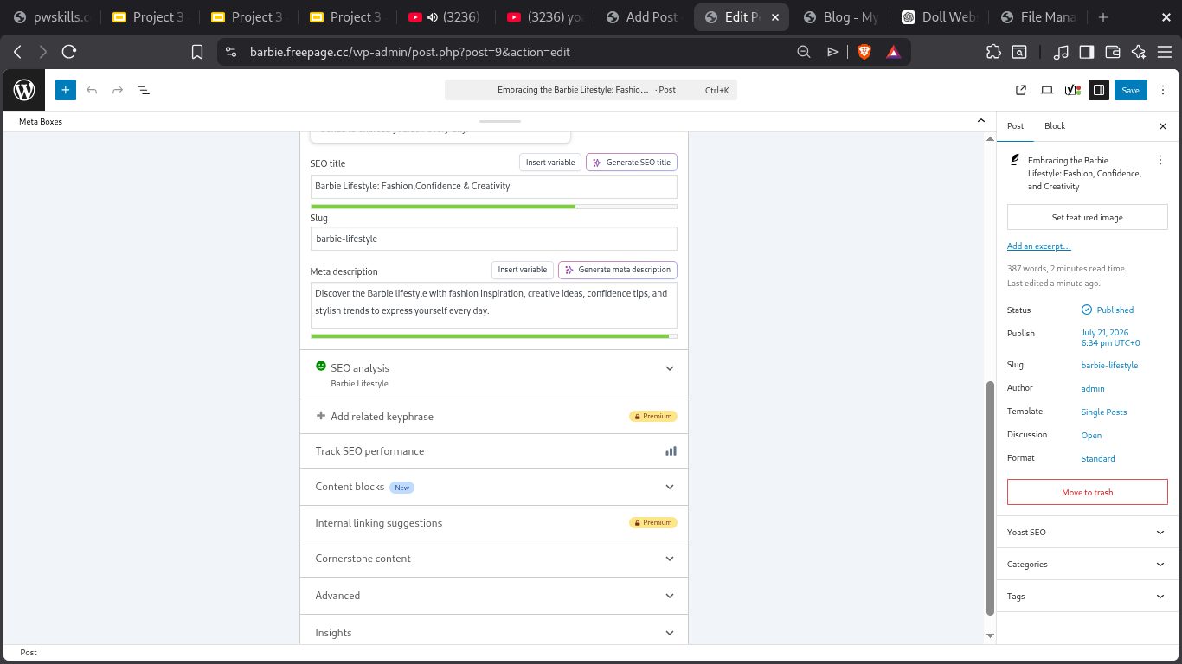
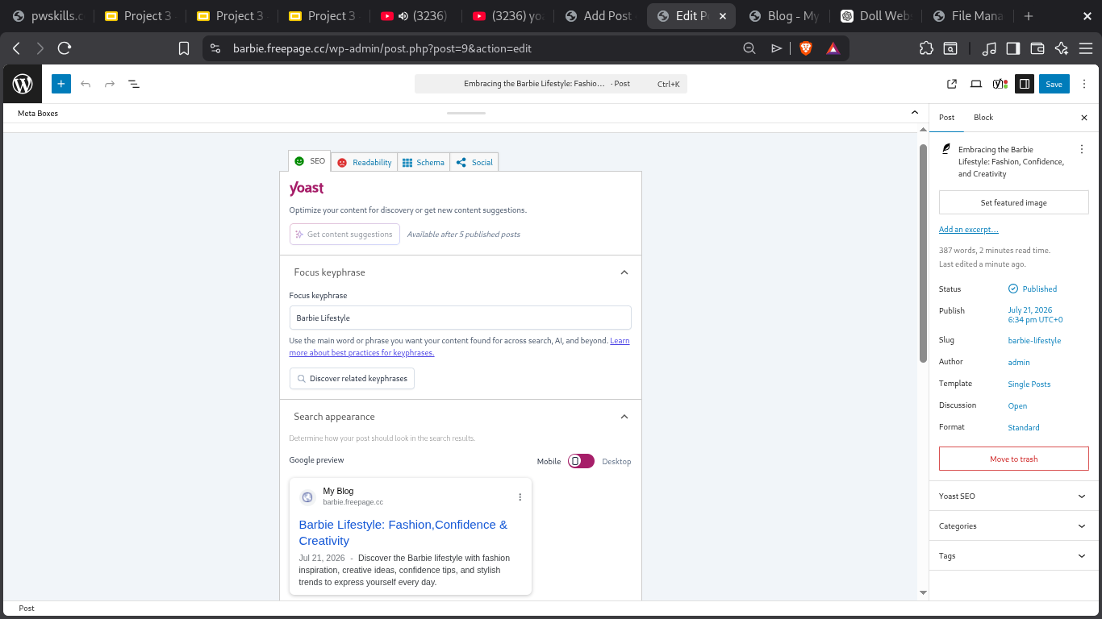
Q.5. Provide the screenshot of “Search Snippet” for any blog post and mention the “Focus Keyphrase” of that blog post.

Slide 7
Q.6. Recording Summary (Record 1 minute summary of the project with below mentioned points:
What activities you have performed in this assignment?
What are your key learnings?
Video Guidelines:
In the video, your face is mandatory with a silent background.
You can use Google Meet or Zoom to record this 1 minute video.
You may also use your mobile device for the recording.
Upload this video on Google Drive and Share Access of the link to all so that evaluator can check it.)
https://drive.google.com/file/d/1tvnhRo6FO-IcjlSQyXdLnON6TjM44FZP/view?usp=drivesdk

